Slide 1
Capstone Project
Presented By Group - eShield
Rajiv, Chintan & Hardik

Slide 2
Project Team and Task Allocation
Chintal Joshi | Questionnaire Framing, Data Collection, Data Pre-Processing, Noise Reduction, Report Writing
Rajiv Trivedi | Data Collection Strategies, Exploratory Analysis, Logistic Regression, Predictive Analysis, Report Writing
Hardik Raval | Linear Regression, Inference, Report Writing

Slide 3
Project Introduction
Project Inferences
Understand safety perception variation by age groups
Uncover online services usage patterns (payment, purchases, learning)
Control measures against cyber security threat
Usage of advance technology for safe online transactions
Expected Outcomes
Insights into online transaction adoption factors and safety perceptions of users
Design strategies for e-services providers, network protecting tools and software providers, policymakers, and businesses
Data Collection and Confidentiality
Survey distributed with privacy and security considerations
Voluntary participation with informed consent
Data anonymized and aggregated for confidentiality

Slide 4
Method
Define research Questions
Data Collection (Ahmedabad Geography)
Data Normalization
Exploratory Analysis
Predictive Analysis
Conclusion

Slide 5
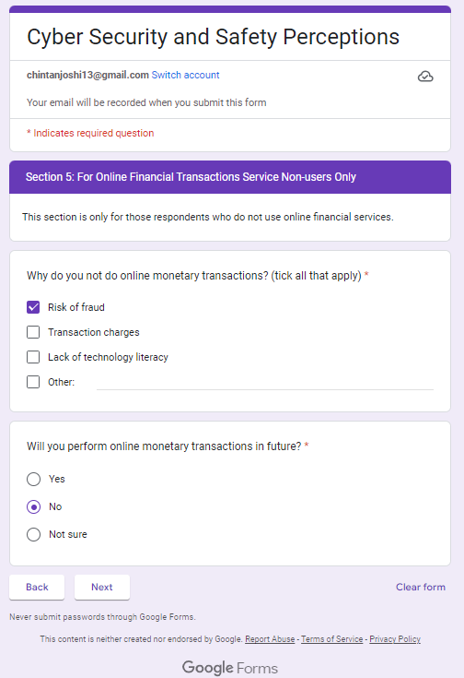
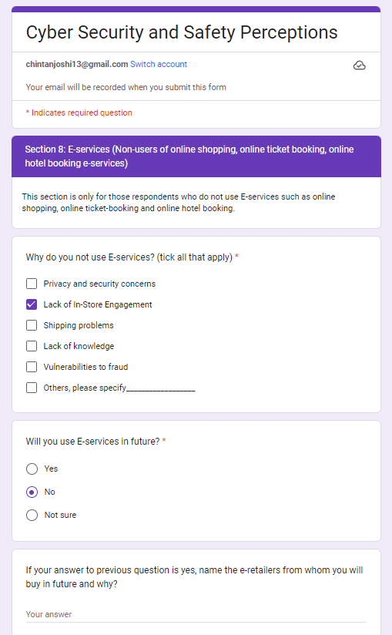
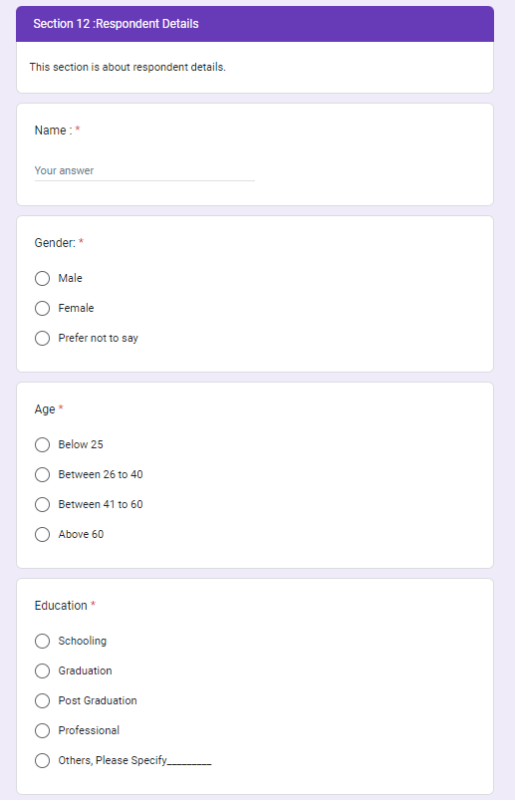
Data Collection by Survery
Information Collected via 54# Questions framed in Google Form
Sample Size > 100
Geography : Ahmedabad
Age Group : < 60 Years
https://forms.gle/eidJ1KNXuTGur3NB9

Slide 6
Define Questions for the Data
Reponses by various factors : Age, Income, Occupation
How people are concerned about Cyber Security
How much people are aware about possibilities of fraud
Who are likely to lose the money in fraud
Define Questions for the Data
Define Questions for the Data

Slide 7
Project Time Plan
Data Collection : By 5th Nov
Review and Cleaning of Data: By 7th Nov
Data Analysis : By 10th Nov
1st Review : 7th Nov
2nd Review : 22nd Nov
3rd Review : 24th Nov
Correction and Presentation : 25th Nov
Final Report : By 2nd Dec

Slide 8
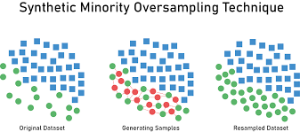
Data Normalization
Challenges Observed During Analysis
Sample Size is Small ~ 106#
Response is skewed to “ Yes” with very little information for “ No”
Data Corrected by
Added dummy columns
Fixed open text data
Removed incomplete data
Data Balanced by
Upscaling with help of SMOTE
Synthetic Minority Oversampling Technique
106# data upscaled to 163#

Slide 9
Analysis
Exploratory Data Analysis
Tableau Dashboard
Binary Classification
Logistic Regression
Regression and Classification by Ensemble
Random Forest (concerned/not concerned)
Consumer Behavior Pattern
Market Basket

Slide 10
Tableau Dashboard Outputs

Slide 11
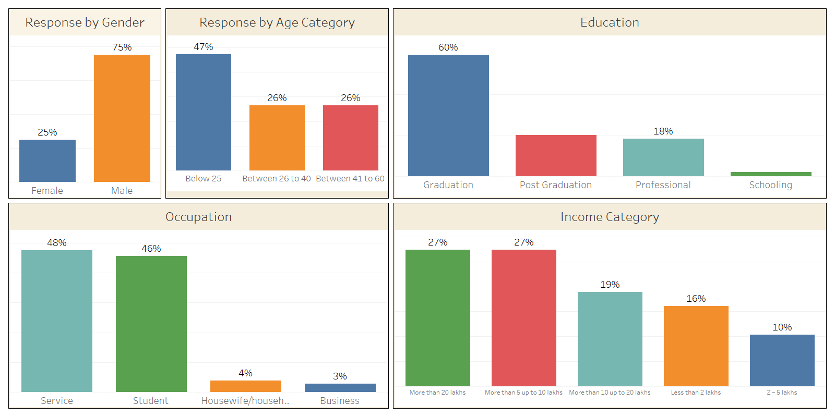
Demography
Response Summary by Respondents Demography
Define Questions for the Data
Define Questions for the Data
Total Respondents are 106#
9% among this sample are not performing Online Transactions
Out of Remaining 91%, 50% are Young Group and 50% are professionals

Slide 12
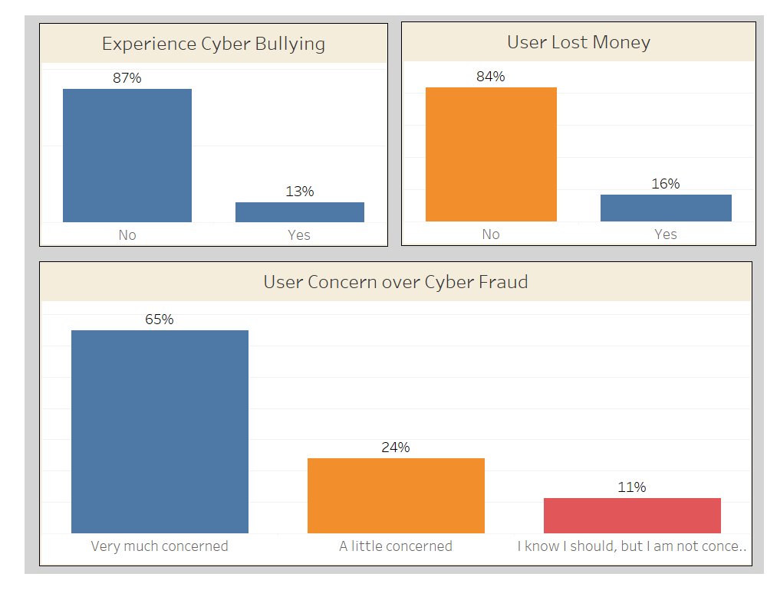
Respondents Experience and Perception about Cyber Bullying
Define Questions for the Data
Define Questions for the Data

Slide 13
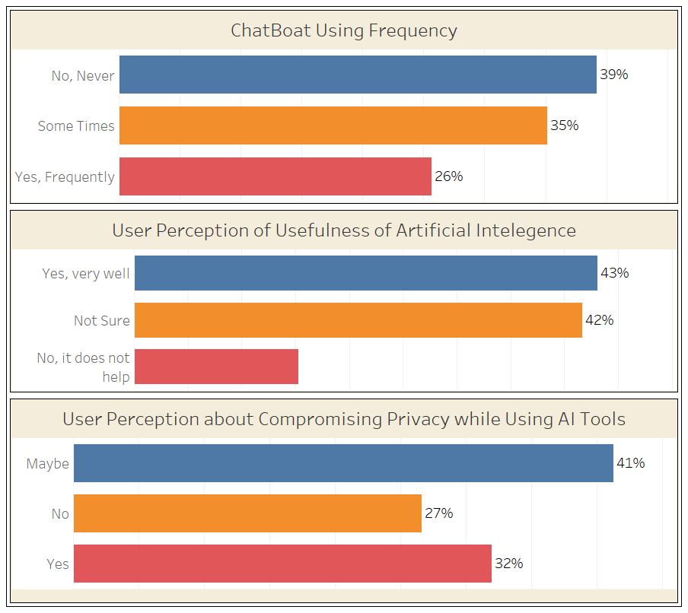
Perception about Artificial Intelligence Tools like Chatbot
61%
85%
Define Questions for the Data
Define Questions for the Data

Slide 14
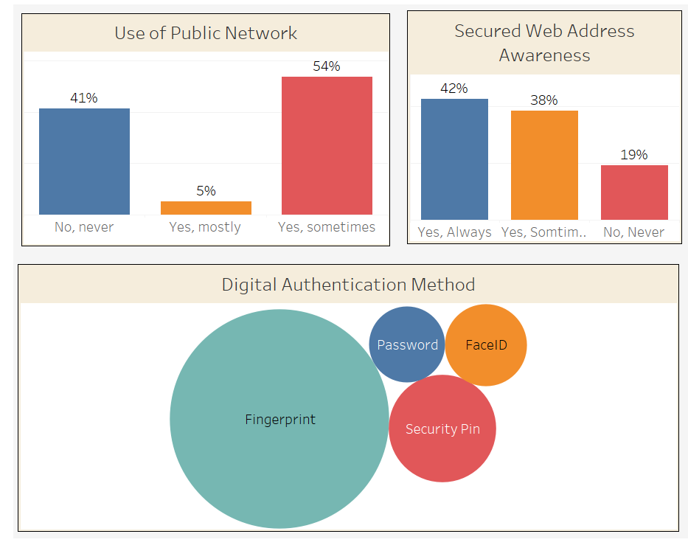
Digital Authentication and Precaution
Define Questions for the Data
Define Questions for the Data
Using Public Network and Browsing through https:\\ may not reduce risk of cyber fraud

Slide 15
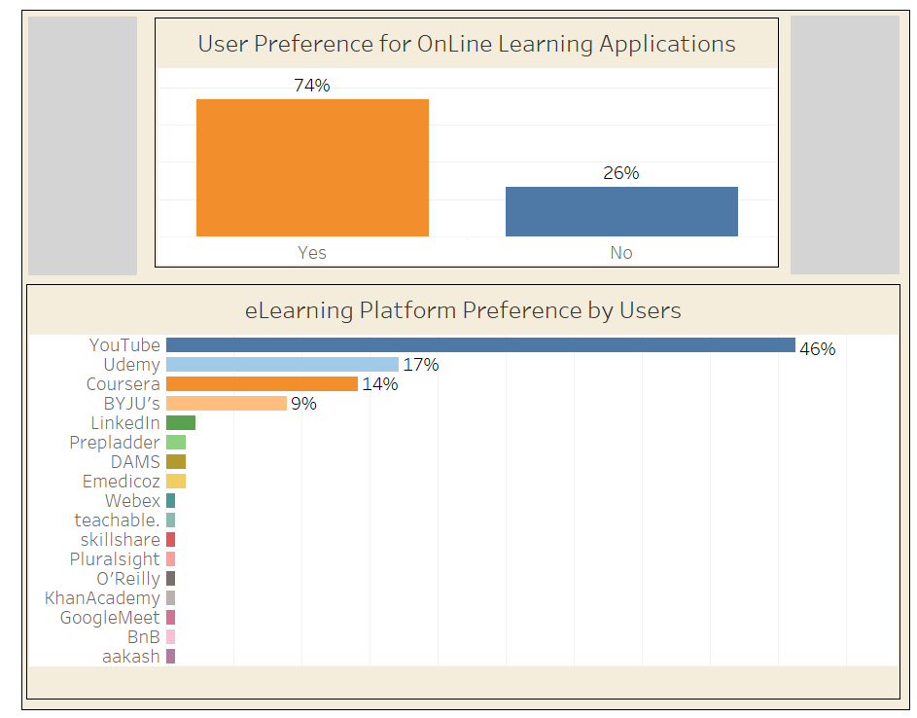
eLearning Platform
Define Questions for the Data
Define Questions for the Data
Top Three Learning Platforms
You Tube
Udemy
Coursera

Slide 16
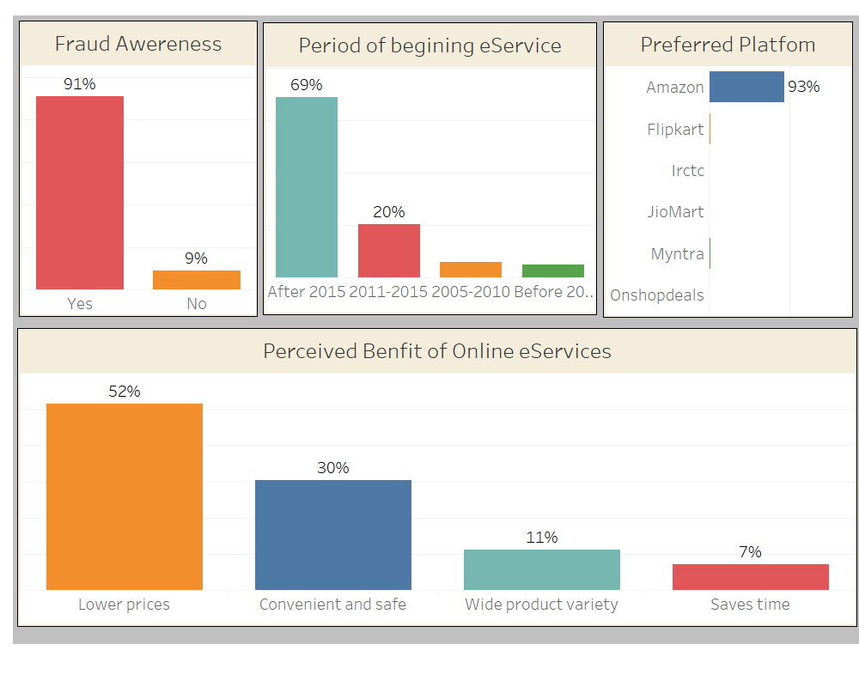
eServices
eService Growth
After Year 2015
Amazon is Most Popular
Define Questions for the Data
Define Questions for the Data
Key Factors for User Preference
Lower Price and Convenience

Slide 17
Random Forest

Slide 18
Analysis :
Random Forest
To analyze the characteristics of individuals susceptible to falling
victim of online transaction fraud.

Slide 19
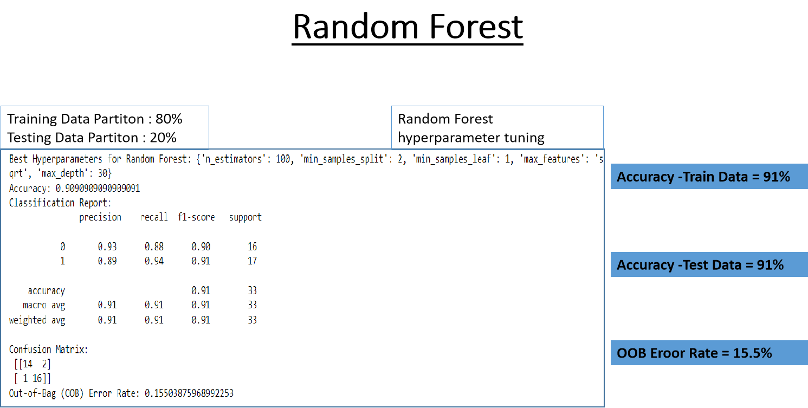
Random Forest

Slide 20
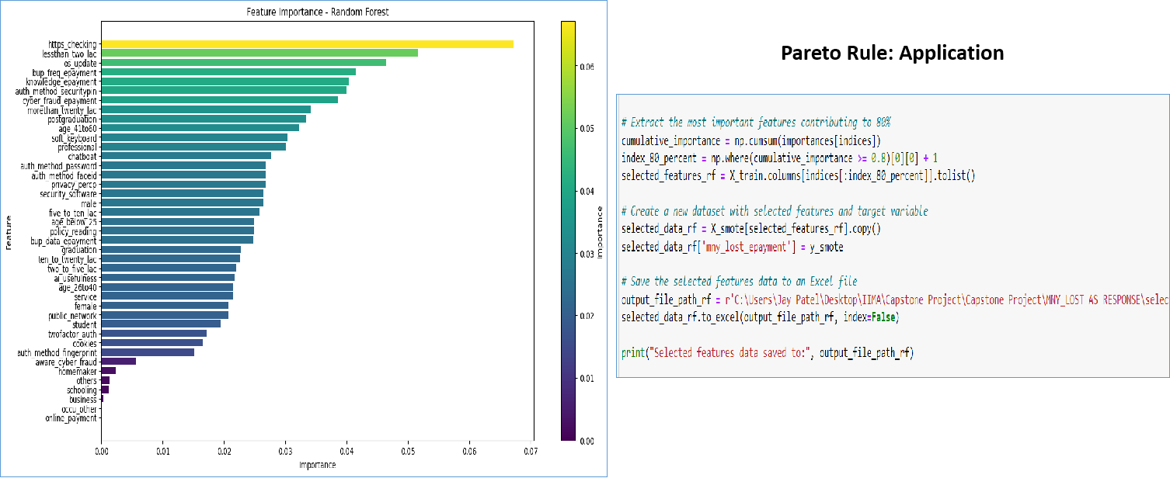
Random Forest
Important
Features
Pareto Rule
Application

Slide 21
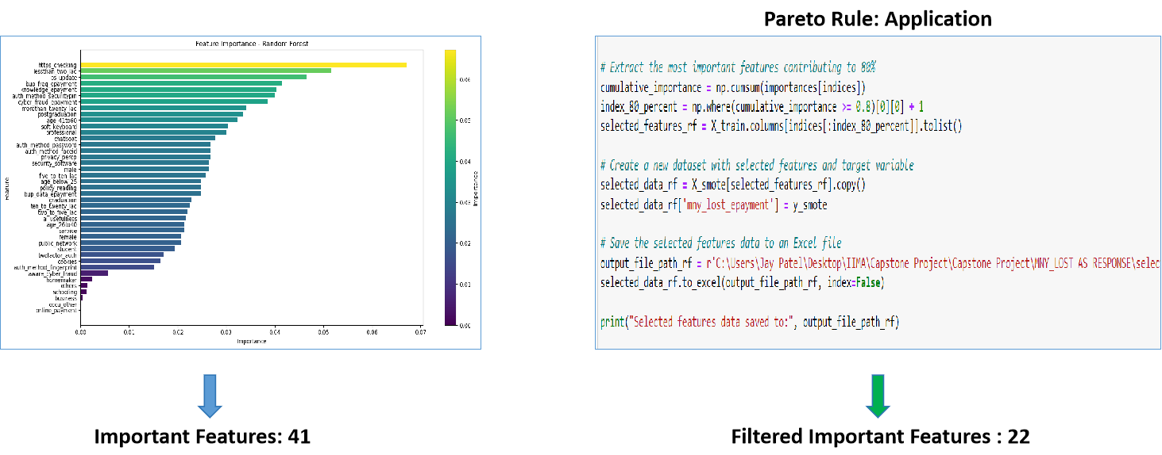
Important
Features
Pareto Rule
Application
Final Filtered
Features

Slide 22
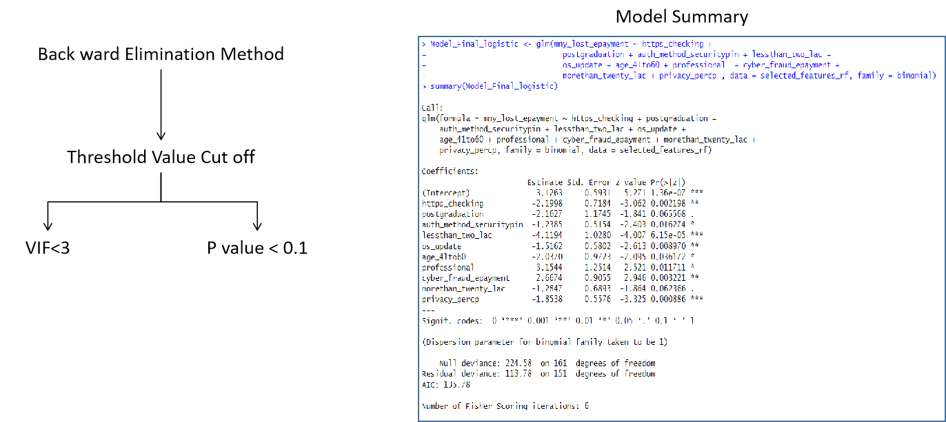
Logistic
Regression
Back ward
Elimination
Final Model
Summary

Slide 23
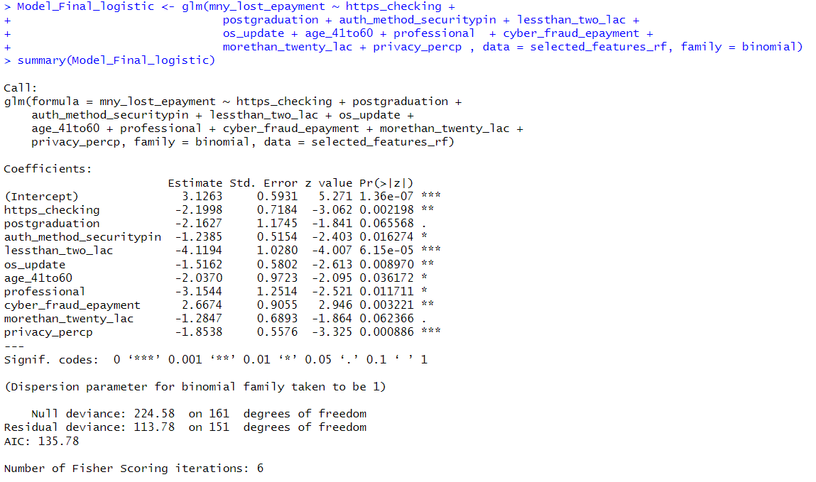
Logistic
Regression
Back ward
Elimination
Final Model
Summary
Significant Variables
10

Slide 24
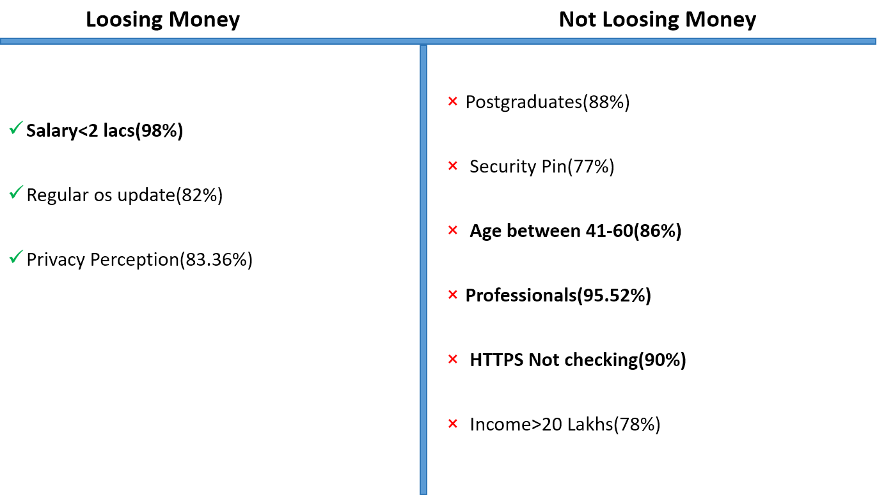
Conclusion

Slide 25
Logistic Regression
Dependent Variable : “ Concern”

Slide 26
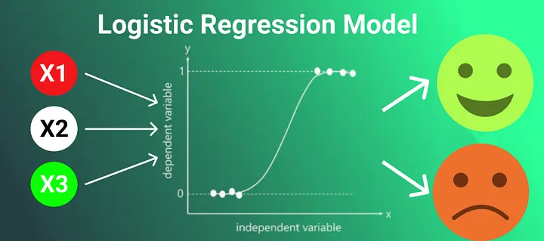
Predict how concerned are people about security on internet
Response Variable : Binary
1-> Very much concerned
2-> Not concerned
Explanatory Variable
Demographics (i.e Age, Gender, Profession, income)
Define Questions for the Data
Define Questions for the Data
Method
library loads
Read Data
Used one hot encoding (introducing dummy colums for categorical variables
Used SMOTE to upsize data
Run the Initial Model
first output
Remove singularities and variable based on p-value and vifs
Prediction
ROC Curve and find optimum threshold and optimum prediction-
Choose threshold with max sensitivity code

Slide 27
Predict how concerned are people about security on internet
Initial Model
logistic_model <- glm(concern_binary ~ is_male + is_female + age_group + is_graduate + is_postgraduate + is_schooling + is_other_education + is_business + is_service + is_student + is_homemaker + income_group, family = binomial, data = data)
Final Model
final_model <- glm(concern_binary ~ age_group + is_student, family = binomial, data = data)
Call:
glm(formula = concern_binary ~ age_group + is_student, family = binomial,
data = data)
Coefficients:
Estimate Std. Error z value Pr(>|z|)
(Intercept) 5.0151 1.6287 3.079 0.002076 **
age_group -1.7268 0.6137 -2.814 0.004897 **
is_student -3.5396 1.0728 -3.299 0.000969 ***
Define Questions for the Data
Concern is depend on variable “ age group” and category “ student”
Outcome
With more than 60% accuracy found relationship of the probability of having people more concerned about security as below

Slide 28
Market Basket
Dependent Variable : “ Concern”

Slide 29
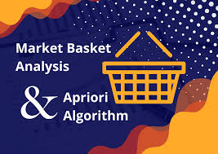
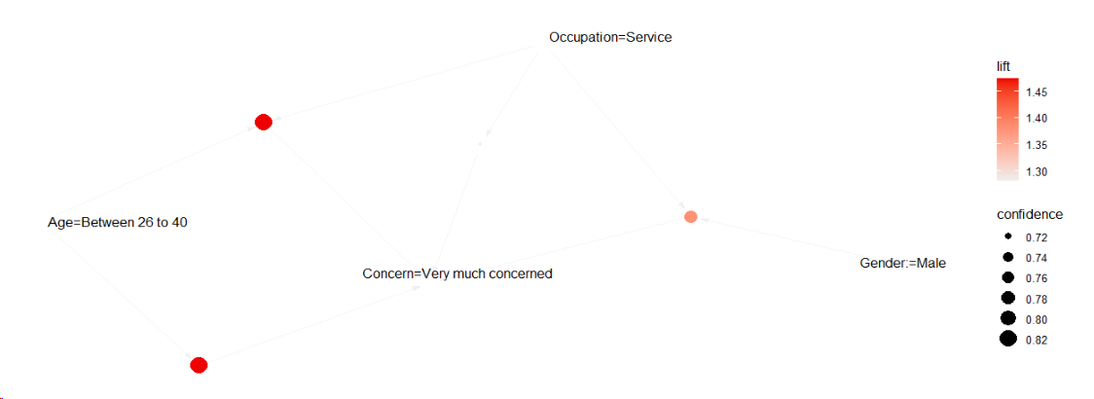
Predict how concerned are people about security on internet
Using Market Basket Analysis to find the rules that has right hand side as
Very much concerned
lhs | rhs | support | confidence | coverage | lift
{Age=Between 26 to 40} | => {Concern=Very much concerned} | 0.2211538 | 0.8214286 | 0.2692308 | 1.472906
{Occupation=Service} | => {Concern=Very much concerned} | 0.3365385 | 0.7142857 | 0.4711538 | 1.280788
{Age=Between 26 to 40, Occupation=Service} | => {Concern=Very much concerned} | 0.2211538 | 0.8214286 | 0.2692308 | 1.472906
{Gender:=Male, Occupation=Service} | => {Concern=Very much concerned} | 0.2884615 | 0.7692308 | 0.3750000 | 1.379310
Define Questions for the Data
Define Questions for the Data

Slide 30
Analysis
Analysis :
Define Questions for the Data

Slide 31
Market Basket
Dependent Variable : “ Fraud Awareness”

Slide 32
Predict how are people not Fraud Aware
Using Market Basket Analysis to find the rules that has right hand side as
fraud_awareness = No
lhs | rhs | support | confidence | lift
------------------------------------------ | ----------------------- | -------------- | ------------ | -----
{information_security_knowledge=No, | {fraud_awareness=No} | 0.02884615 | 1 | 26
data_backup=No,
two_factor=No,
Gender:=Female}
------------------------------------------ | ----------------------- | -------------- | ------------ | -----
{public_network=Yes, sometimes, | {fraud_awareness=No} | 0.02884615 | 1 | 26
data_backup=No,
two_factor=No,
Gender:=Female}
------------------------------------------ | ----------------------- | -------------- | ------------ | -----
{transaction_method=UPI, | {fraud_awareness=No} | 0.02884615 | 1 | 26
data_backup=No,
two_factor=No,
Gender:=Female}
------------------------------------------ | ----------------------- | -------------- | ------------ | -----
{transaction_method=UPI, | {fraud_awareness=No} | 0.02884615 | 1 | 26
information_security_knowledge=No,
data_backup=No,
two_factor=No,
Gender:=Female}
------------------------------------------ | ----------------------- | -------------- | ------------ | -----
Define Questions for the Data
Define Questions for the Data

Slide 33
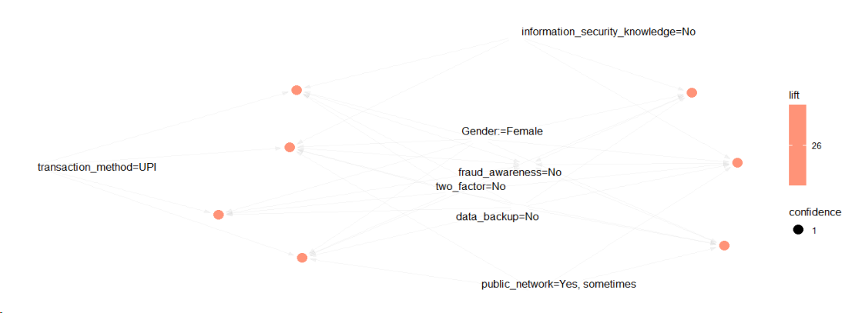
Predict how are people not Fraud Aware
Define Questions for the Data
Define Questions for the Data

Slide 34
Predict how are people not Fraud Aware
Used Market basket analysis Using Language R
information_security_knowledge=No
data_backup=No
two_factor=No
Gender:=Female
The rules suggest a strong association between the specified conditions in the lhs and the absence of fraud awareness (fraud_awareness=No).
Factors which predicts No Awareness about Cyber Frauds are
lack of information security knowledge,
no data backup,
no two-factor authentication,
and are female,
they are highly likely to not have fraud awareness.
The rules have high confidence, indicating a strong predictive power for the absence of fraud awareness given the specified conditions.
Define Questions for the Data
Define Questions for the Data

Slide 35
Analysis
Analysis :
Define Questions for the Data

Slide 36
Random Forest
Dependent Variable : “ Fraud Awareness”

Slide 37
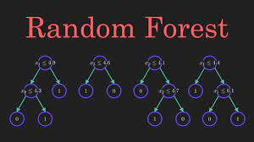
Predict how are people not Fraud Aware
Using Random Forest Method
fraud_awareness=No
Explanatory Varialbles
doing_transaction
transaction_method
concerned
os_update
public_network
information_security_knowledge
data_backup
data_backup_scheule
network_security
lost_money
two_factor
gender
Age
Education
Occupation
income
Define Questions for the Data
Define Questions for the Data
Tree 500
Number of variable 4 ~ SQRT(16)
Used smote to upsize data

Slide 38
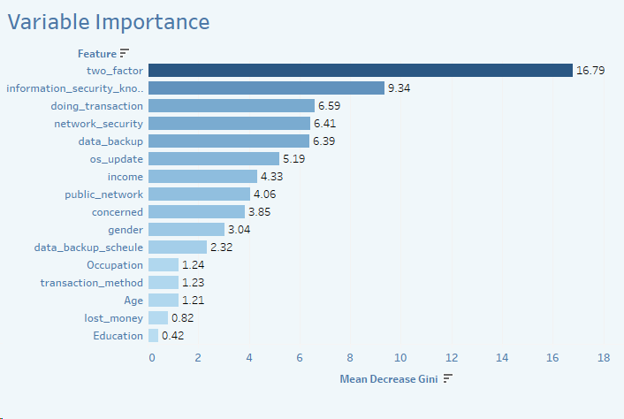
Predict how are people not Fraud Aware
100% Accuracy to predict Fraud Awareness on train, testing, all data
Define Questions for the Data
Define Questions for the Data

Slide 39
Market Basket
Dependent Variable :
“ eLearning Platform”

Slide 40
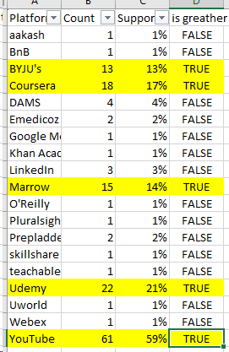
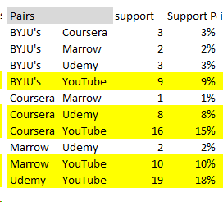
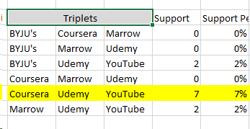
Study the usage pattern of online learning platform in combinations
Study the usage pattern of online learning platform in combinations
Minimum Support | 5%
Minimum Threshold | 75%
Define Questions for the Data
Define Questions for the Data

Slide 41
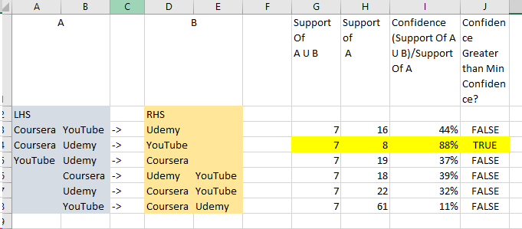
Study the usage pattern of online learning platform in combinations
Study the usage pattern of online learning platform in combinations
Minimum Support | 5%
Minimum Threshold | 75%
Define Questions for the Data
Define Questions for the Data
Conclusion with 88% confidence we can say that
people using coursera and udemy also uses youtube.

Slide 42
Summary of Analysis
Analysis Findings:
Random Forest:
Predictive Analysis :
Market Basket: People using coursera and udemy also uses youtube
Key Learnings :
Sample Size should be atleast 200#
Imbalance Data can be corrected with help of Tools like SMOTE
Future Scope Study:
Analysis with Continuous Data
Money Lost by Amount
Measures which help to Avoid Cyber Fraud
AI Tools Popular Platforms and Applications

Slide 43
Thank You

